Slide 1
“Raspberry Jam” Monitoring your world

Slide 2

What is the problem?
JAM
Existing home security and environment monitoring systems are expensive and often times bulky.
Our goal is to design a working prototype that is cheaper and has more configurability than current solutions on the market
As an example, consider Nest. Nest sells HI definition cameras whose video feed can be viewed remotely using a smartphone. The cost for one of these cameras? $200…
We beleive our system can achieve the same functionality for a fraction of the cost, albeit at a lower video resolution

Slide 3
Summary and Motivation of Project Goals
JAM
Create a working prototype capable of streaming video, motion sensing alerts, and other useful information to a web page accessible remotely by any device with a web browser
Our team’s motivation for this project was driven primarily by our desire to test and develop our skills in creating an embedded system that communicates over the web. Additionally, we sought to create a system that is more affordable than current market solutions.
One of the key features of our product resides in it’s configurability. We seek to create a product whose hardware can be easily customized, thereby enabling each user to add or remove specific features based upon there application

Slide 4
Proposed Solution
JAM
Our design utilizes a Raspberry Pi Model B acting as an intermediary between our home monitoring system and a website hosted locally on the Pi. *Note- Use of the term “Pi” refers specifically to the Raspberry Pi Model B Microcomputer
Our monitoring system will include a camera, a motion detector, and an alarm system.
Our monitoring system will also be configurable, meaning additional hardware can be added or removed if the user wants more (or less) functionality from the system based upon their needs
Some current ideas for add-ons include temperature sensors and light sensing diodes capable of monitoring temperature and room brightness

Slide 5
Specifications
JAM
The primary selling points of our product are its low cost relative to similar solutions on the market and its hardware configurability.
Our system will be capable of monitoring environmental conditions in a single 20x20 square foot room.
Multi-room monitoring is also a viable feature. This implantation would require a secondary PCB, and while we will not be implementing this feature in the prototype, we plan on providing the software framework to make this possible as a testament to the device’s configurability. In other words, adding a second monitoring system would be a “plug-and-play” feature.

Slide 6
Technical Specifications/Performance
JAM
Feature | Specifications
Size and weight | 120 cubic inches; 3 lbs
Video Output | 480p continuous video stream
Power Consumption | 0.06 kWh per month if monitoring is active 80% of the time
Motion Sensor Range (Maximum room size) | 20 feet
Alarm | Store up to 5 custom alarm sounds at any time
Connectivity | Any device with an internet connection and HTML5 capable web browser
Hardware Add-ons | Temperature Sensor, Light sensor
Maximum number of rooms that can be monitored | 2

Slide 7
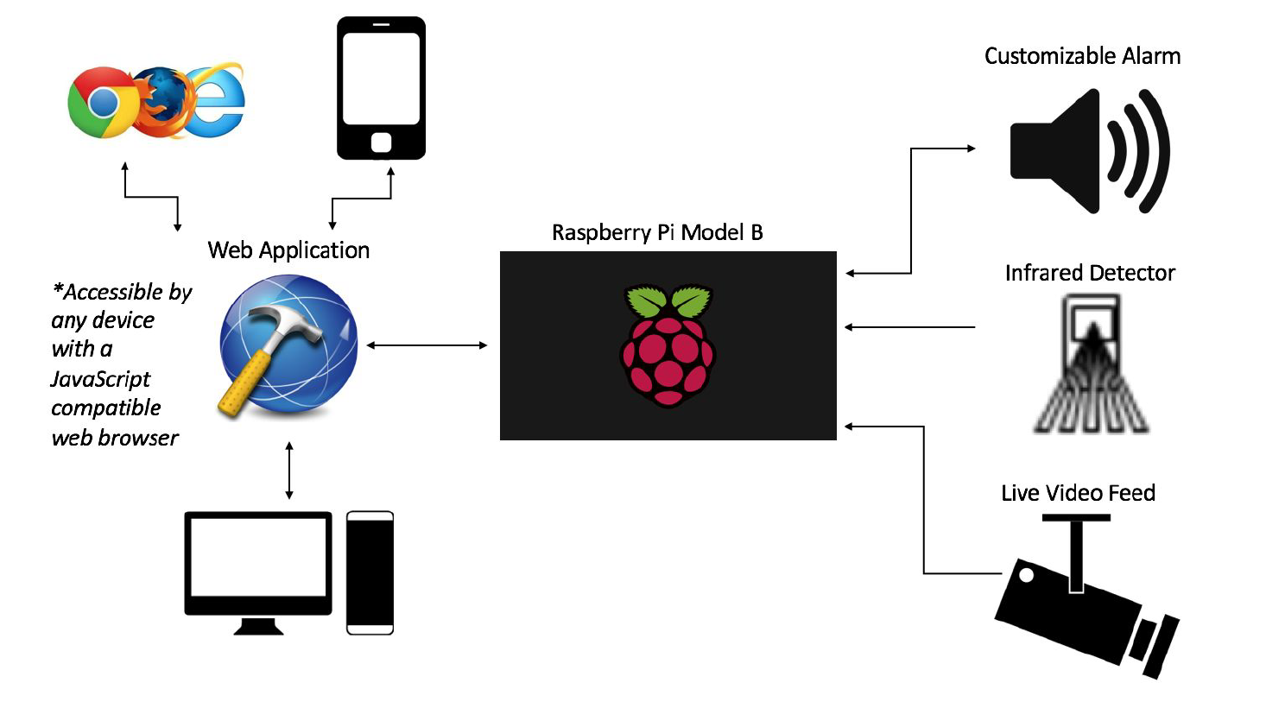
Design Approach
On Board PCB
Light Sensing Diode
JAM
Temperature Sensor

Slide 8
Design Approach cont.
JAM
Our design features a custom PCB on which all hardware components will either be mounted with screws or soldered on.
Just as the Pi acts as an intermediary for processed data between the PCB and the web server, the PCB acts as the intermediary for raw data between the monitoring components (video camera, motion sensor, and alarm system) and the Pi

Slide 9
Design Control Flow
JAM
Raw data is acquired from the video camera, motion detector, and alarm system, temperature sensor, and light sensing diode
On board PCB circuit routes acquired to appropriate GPIO pin on the Pi. Some hardware components, such as the temperature sensor and light sensing diode output analog signal, these signals will be converted to digital using an ADC on the PCB. (The Pi does not have any analog input or output pins)
Using Python scripts running locally on the Pi, the raw data will be processed and interpreted into meaningful data.
This data will be sent over the network to an http web server hosted on the Pi.
The web page URL will be accessible by any device with a web browser
From the web page, commands can be sent to the Pi. These include shutting the monitoring system off, controlling alarm output sound and volume, and disarming the motion sensor.

Slide 10
Manpower
JAM
Mike – JavaScript web application, network bidirectional communication (websocket)
John – PCB design (CAD), Python Scripting, hardware prototyping
Thadoe – PCB physical circuit design, Software debugging (Python and JavaScript), webserver

Slide 11
Schedule
Mike
Thadoe
John
All
JAM

Slide 12
Cost Estimate
JAM
Component | Price
Raspberry Pi Model B | $35.00
ADC (MAX11645EUA+) (x2) | $2.70 |  | 10-bit | 2 channel | I2C | SAR
Rasp Pi On Board Cam | $16.41
Speaker (x2) | $1.98 |  | 0.2W | About 80 dB | 8 Ohm | 30 mm Diameter
Temperature Sensor (x2) | $1.98
Op Amp (x2) | $1.98 |  | 4 Channel | 3 MHz | 70 dB
Photodiode (x2) | $1.98
Case Sheet Metal | $8.80
Printed Circuit Board | $30.00
Bulk Components | $10.00
Relay(s) | $10.00
Total Hardware Cost | $110.83
Engineering Cost/Salary | $28,800 |  | Total manhours: 180 |  |  | Hourly Wage $80 | (100% overhead)
Total Development Cost | $28110.83

Slide 13

Meet our Team!
JAM
Mike Ross
John Darling
Thadoe Swan-Yi

Slide 14
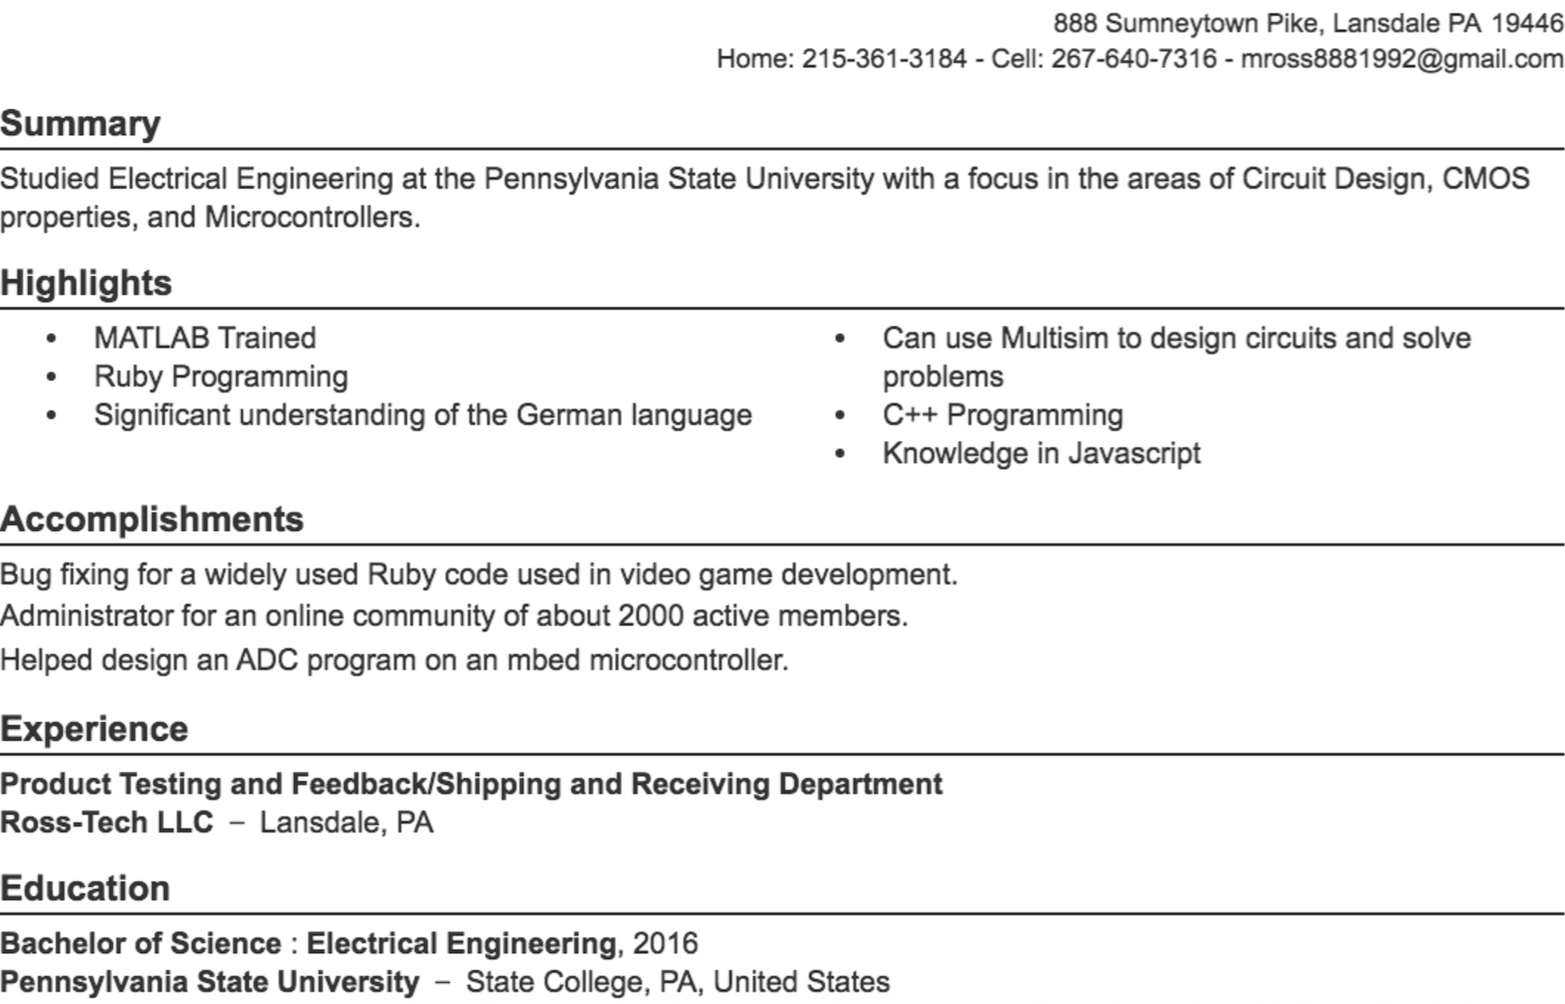
Mike Ross
JAM

Slide 15
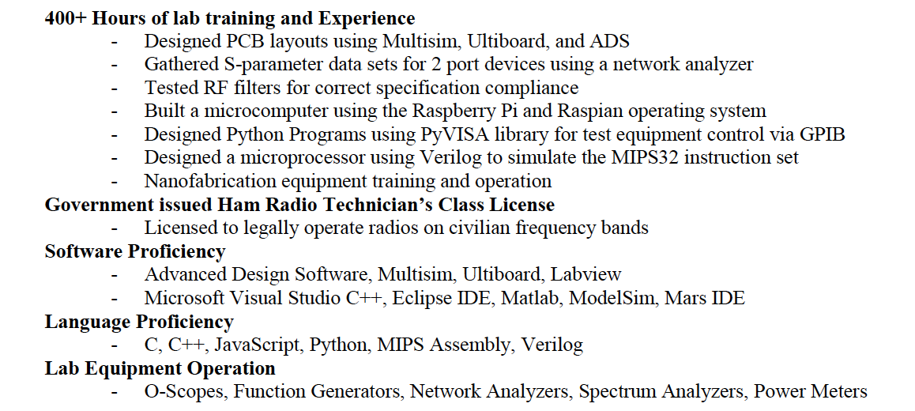
John Darling
JAM
Technical Experience/Skills

Slide 16
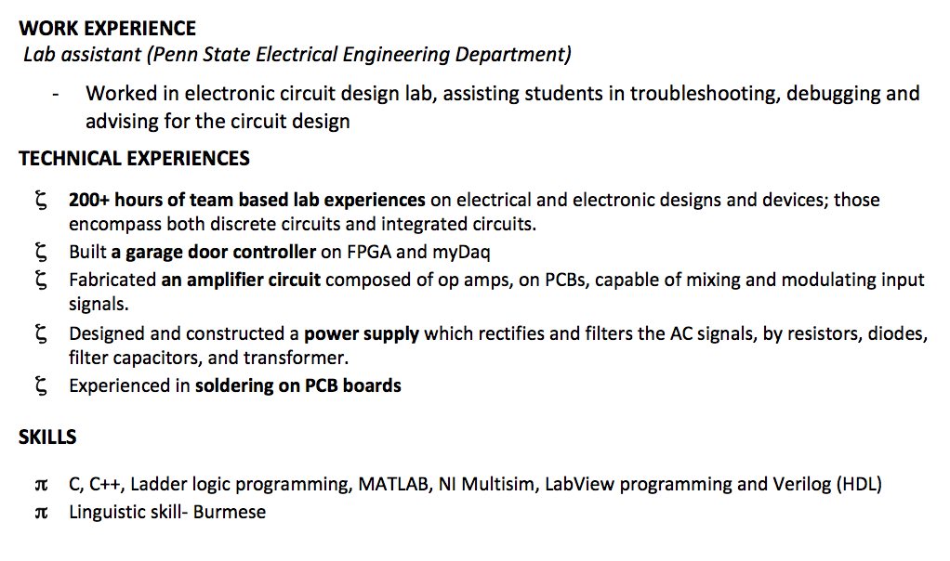
Thadoe Swan-Yi
JAM

